Slide 1
Bravo! For the Bodacious Brain

Slide 2
What’s 3 lbs, pinkish-gray all over, wrinkled like a walnut, and has the texture of oatmeal?

Slide 3
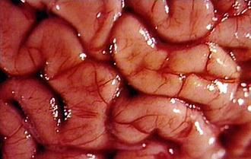
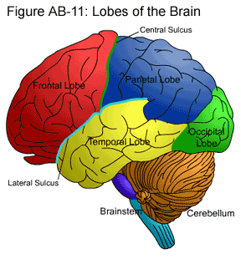
I. Cerebral Hemispheres
Paired (left and right)
A. Anatomy
Gyri and sulci: elevated ridges and shallow grooves
Fissures: deep grooves, separate large regions of the brain
Lobes: sections named after the bones near them

Slide 4
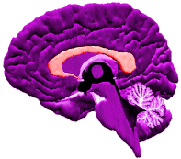
A. Anatomy (cont)
*CORPUS CALLOSUM
Very large nerve tract, connects the two hemispheres, allows the two hemispheres to communicate

Slide 5
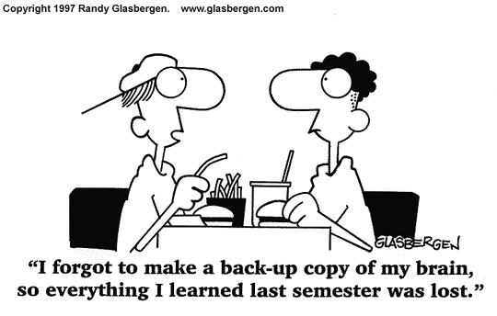
B. Functions
Interprets sensory information
Initiates voluntary muscle movements
Stores information (memory)
Uses memory for reasoning
Emotion
consciousness

Slide 6
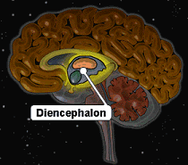
II. Diencephalon (interbrain)
Located between cerebral hemispheres and above the midbrain
A. Thalamus: crude recognition of pleasant and unpleasant

Slide 7
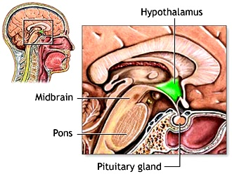
B. Hypothalamus
“under the thalamus”
Regulates body temperature, water balance, metabolism, center for emotion (limbic system)
Thirst, appetite, sex, pain, pleasure

Slide 8
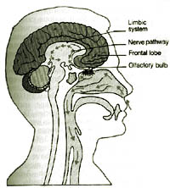
B. Hypothalamus (cont)
Pituitary:
Secretes lots of hormones “master gland”
Mammilary bodies:
Reflex center for smell (olfaction)

Slide 9
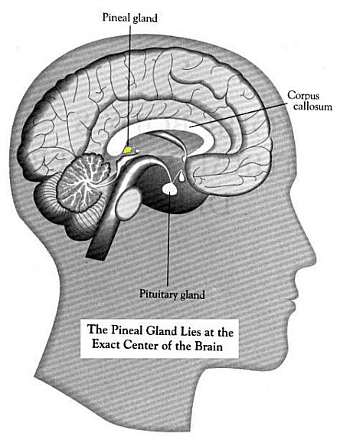
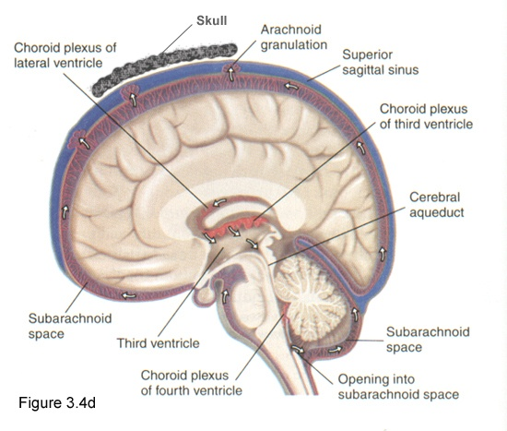
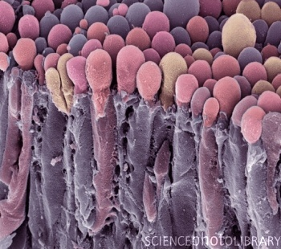
C. Epithalamus
Pineal Body
Regulates day and night cycles
Choroid plexis:
Knots of capillaries that make cerebrospinal fluid

Slide 10
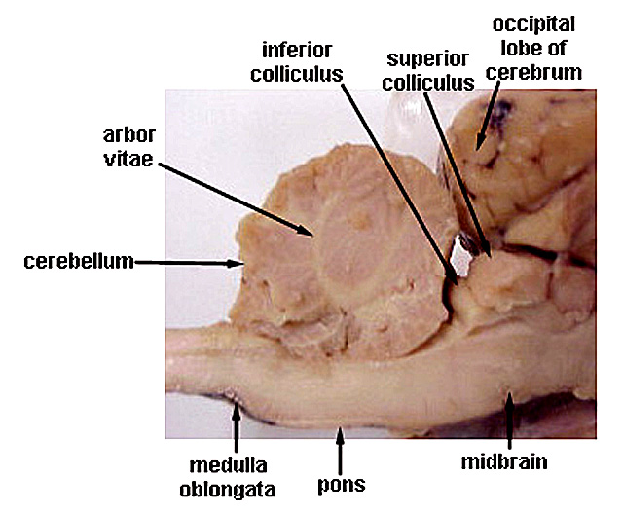
III. Brain Stem
A. Midbrain
Corpora Quadrigemina
Reflex center for vision and hearing
B. Pons
Regulates depth and rate of breathing

Slide 11
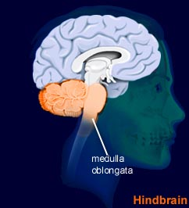
III. Brain Stem
C. Medulla Oblongata
Merges into the spinal cord
Controls heart rate, blood pressure, breathing, vomiting
All nerve fibers connecting brain and spinal cord go through it

Slide 12
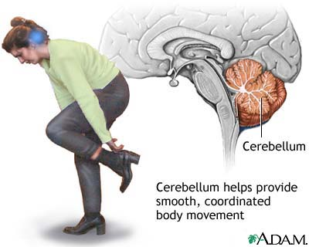
IV. Cerebellum
Looks like cauliflower
Precise timing for skeletal muscle activity
Controls balance and equilibrium

