Slide 1
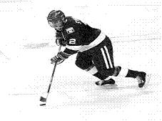
Noteworthy Nervous System
Part 3--Rockin’ Reactions and Reflexes

Slide 2
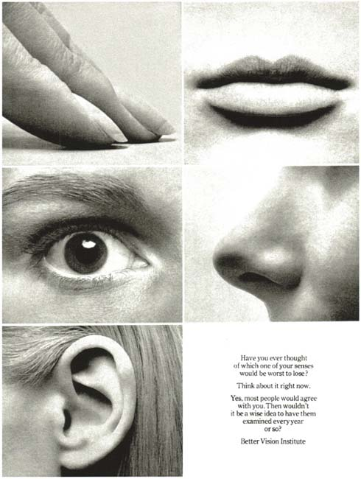
I. Reactions
Voluntary responses to stimulation from the environment
Requires time
Visual: 0.25 sec
Hearing: 0.17 sec
Touch: 0.15 sec

Slide 3
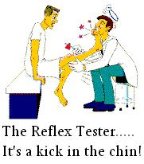
II. Reflexes
A. Characteristics:
Take place without conscious control (often skips brain)
Quick
Purposeful and Involuntary
Always the same (predictable)

Slide 4
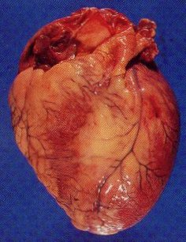
II. Reflexes
B. 2 Types
1. Autonomic Reflexes
Regulate smooth muscles, heart, and glands
EX. Secretion of saliva, change in pupil size (pupillary), digestion, elimination (pooping), blood pressure, sweating

Slide 5
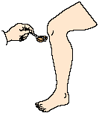
II. Reflexes
B. Types
2. Somatic Reflexes
Regulate skeletal muscles
EX. Knee jerk (patellar), Pulling away from hot stove

Slide 6
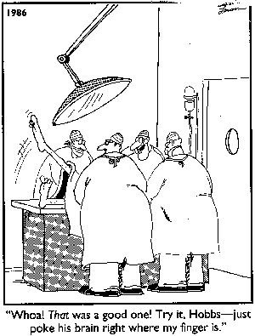
II. Reflexes
C. How They Work
1. Sensory neuron reacts to stimulus
2. Interneuron in brain or spinal cord reacts
3. Motor neuron stimulates effector organ

Slide 7
